Slide 1
Neighbourhood
Plan
2014-2015

Slide 2
Parish Council called meeting 21st October 2013
Application to Become Neighbourhood Planning Area, Posted 28th November
Wilmcote Parish designated a NP Area 24th February 2014
Not designated as a business area
Parish Boundary extended

Slide 3
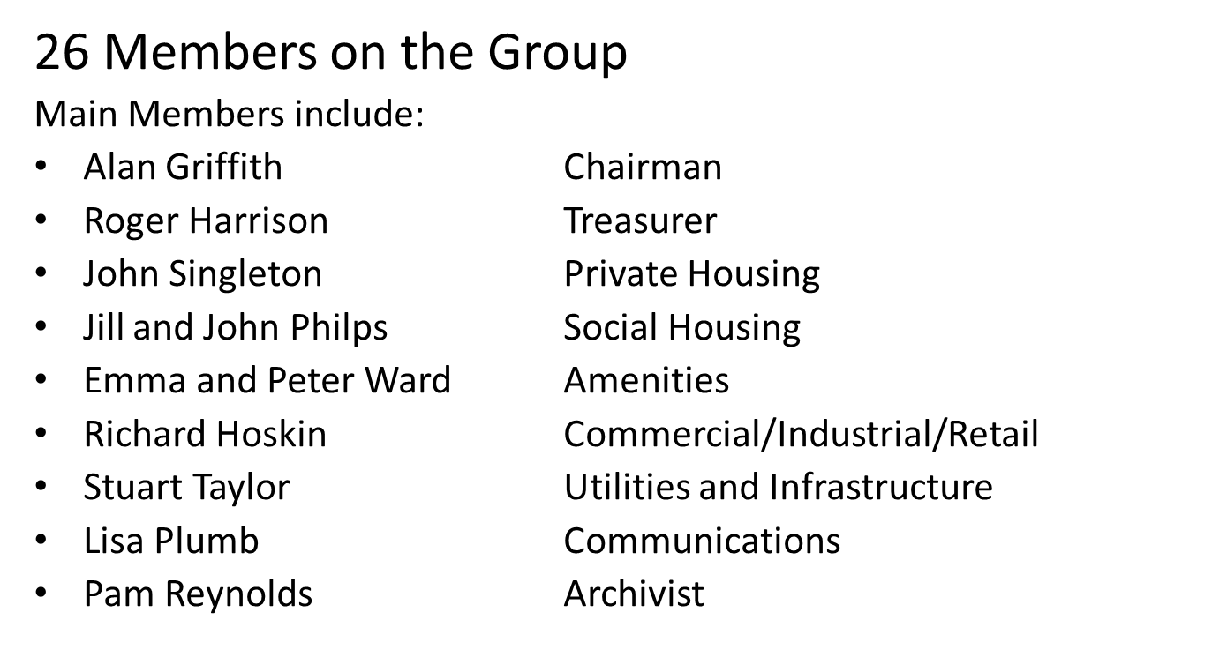

Slide 4
Objectives of Neighbourhood Plan
Community sets guidelines
Set Location for new homes, when required
Type of Houses- Private /Social
Density
Appearance of Housing
Allow for Amenities, Leisure and Business
Monitor Plan

Slide 5
Government Requirements
75 New Homes
When, between 2011 and 2031
11 already received planning
100 granted planning over last 20 years.
Built when demand exists
Contribution to Village Infrastructure etc

Slide 6
Progress to date
Completed Control Plan
Constitution Complete
Sector Research undertaken
Consultation with SDC
Grant Application
Independent Consultant Research

Slide 7
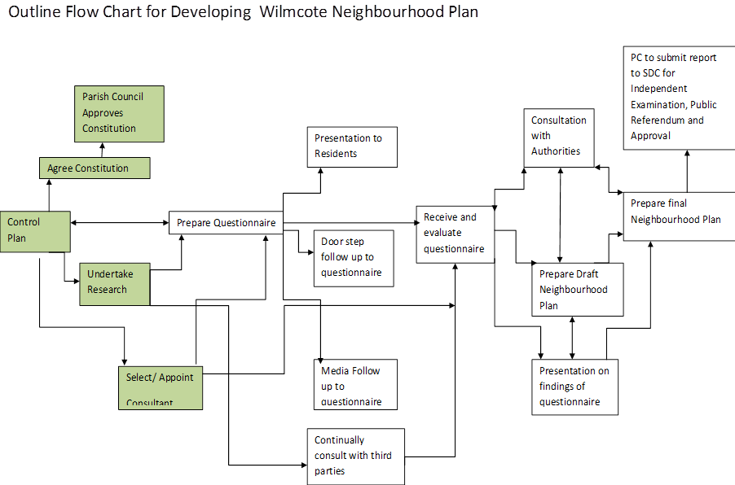

Slide 8
WNPG Private Housing Issues
Demand exceeds supply (for some types of properties)
Should we build more dwellings to support current or increased amenities?
How many - 75 over next 20 years? (built over 100 in last 20 years)

Slide 9
WNPG Social Housing
Assess current demand
 Percentage of Social Housing as a Proportion . of a Development
 Type of Social Housing
- Housing Association/SDC Housing
- Shared Ownership
- Staircase Purchase
 Size of homes to meet demand 2, 3 or 4 Bed

Slide 10
WNPG Commercial/Retail
Expansion of Mary Arden’s House facilities
Utilise Mason Arms Land (conservation area)
Visitor Parking Generally
Shop Parking
Support Businesses in Parish

Slide 11
WNPG Amenities
Village Hall and Parking
Scout Club and Parking
Social Club
Church
School and Parking
Parks/Play Areas
Canal Facilities
Village Green and Conservation Areas

Slide 12
Infrastructure and Utilities
Transport- Highways
-Trains and Parking
Utilities-Gas, Electric, Water, Telecoms, Sewerage
Parking General
Footpaths

Slide 13
Questionnaire Preparation
Team Develops Questions
Mark Potential Housing sites on Map
Check questions with Consultant
Format questionnaire, print and post
House visits by Team as required
Collect questionnaires
Independent Consultant to evaluate

Slide 14
Process to Completion
Prepare draft plan
Environmental research on sites
Further consultation if required
Liaise with SDC and the Authorities
Develop Final Plan
SDC independent scrutiny
Approval of Plan
Continual Monitoring

Slide 16
Housing Sites
Varying size
Close to amenities, including transport
Select 3 sites in order of preference
Place stickers on map of village
This is just part of the consultation process, NOT agreeing sites

Slide 17
Environmental Review
Heritage England
Ecology Review
Archaeological Review
Environmental Agency
Flood Plains
Natural England
Warwickshire Direct

Slide 18
HOW TO CONTACT US and KEEP UP TO DATE
www.wilmcotepc.co.uk/wilmcoteneighbourhoodplanninggroup
follow us on facebook: wilmcoteneighbourhoodplanninggroup
Email : wnpg@wilmcotepc.co.uk
Phone : Alan Griffith - 294776
: Roger Harrison - 298009

Slide 19
